Slide 1
Internal Seminar
Development of VOC sampling systems for drone measurements
Layal Fayad^{1,2}, Joel de Brito¹, Thérèse Salameh¹, Sebastien Dusanter¹, Marina Jamar¹, Titouan Verdu², Luc Fabresse², Guillaume Lozenguez², Noury Bouraqadi², Sebastien Ambellouis²
¹ The Centre for Education. Research and Innovation in Energie et Environnement (CERI EE)
² The Centre for Education. Research and Innovation in Système Numérique (CERI SN)
27/01/2022

Slide 2




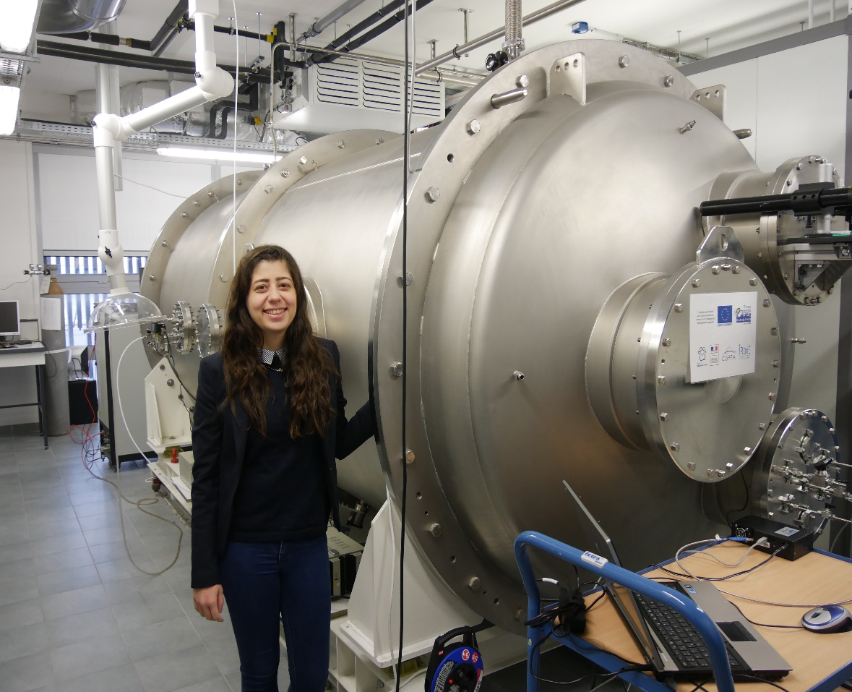


Who Am I
L1-L3: 2010 - 2013 “General Chemistry”
M1: 2013 - 2014 “Environmental Chemistry”
M2: 2015 - 2016 “Atmospheric Environment-Physical & Analytical Chemistry ” M2 internship “Investigation of the nucleation thresholds for the
ozonolysis of various BVOCs”
PhD: 2016 - 2019 “Sciences de la Terre et de l’Univers ”
“Characterization of the new simulation chamber ‘CHARME’
& the study of ozonolysis of γ -terpinene”
Post doc: December 2020 - November 2021 CERI EE/SN
“Development of an innovative VOC sampling system for drone
measurements ”

Slide 3
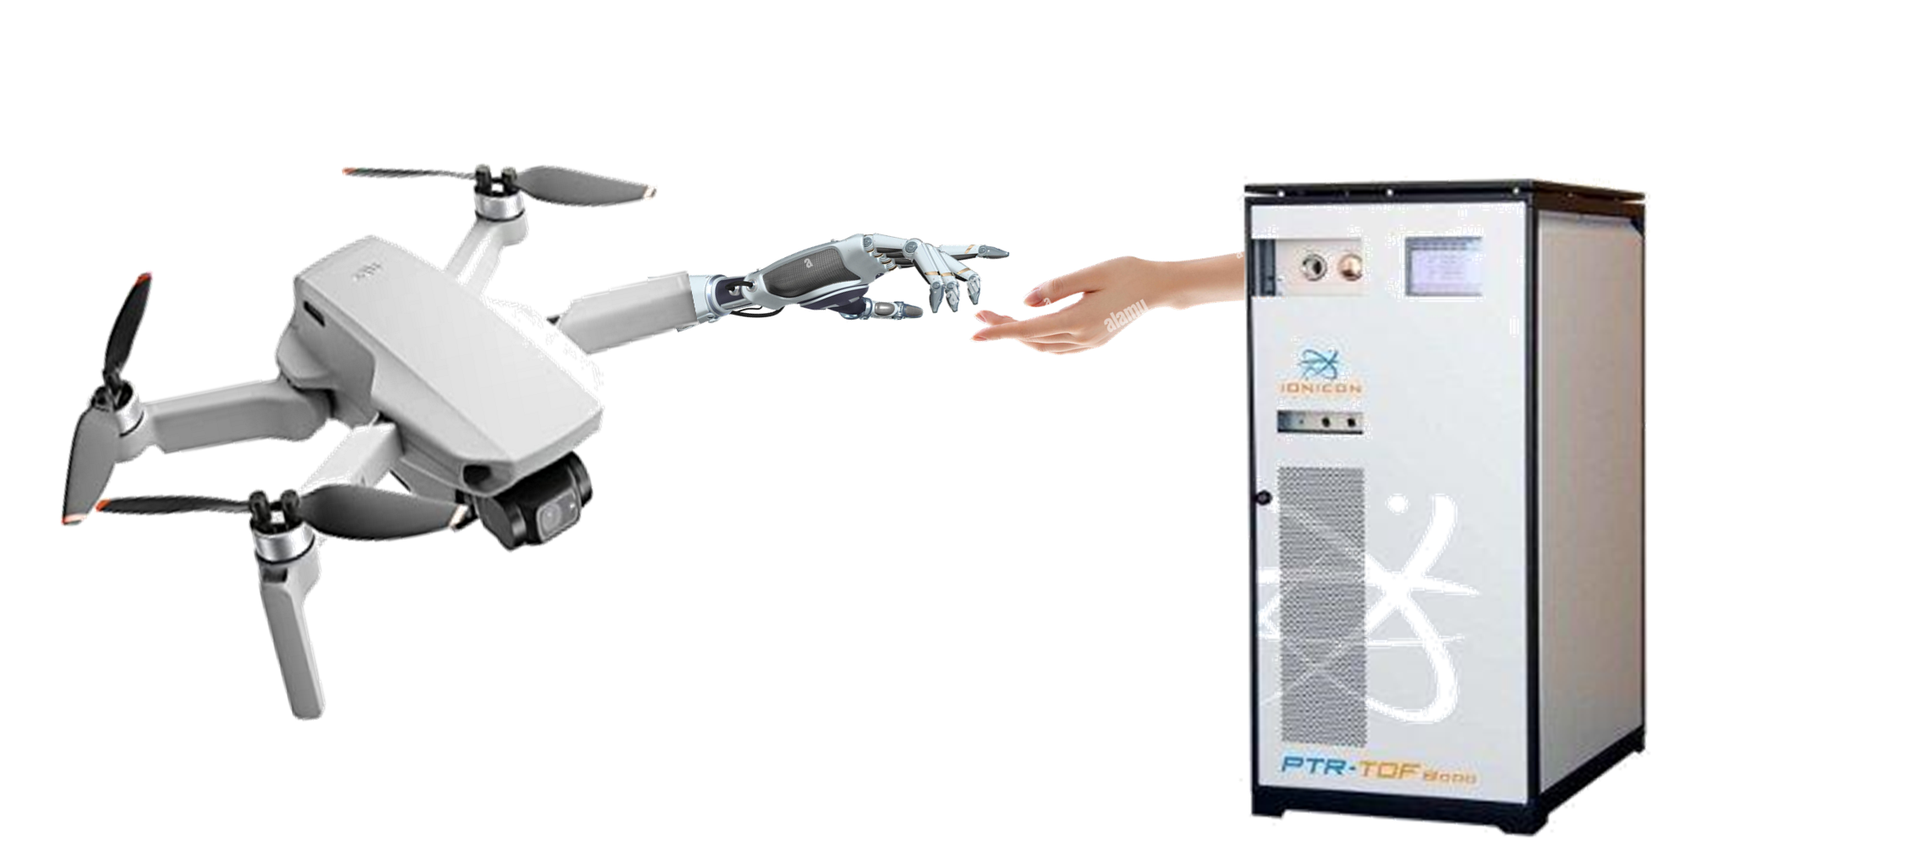



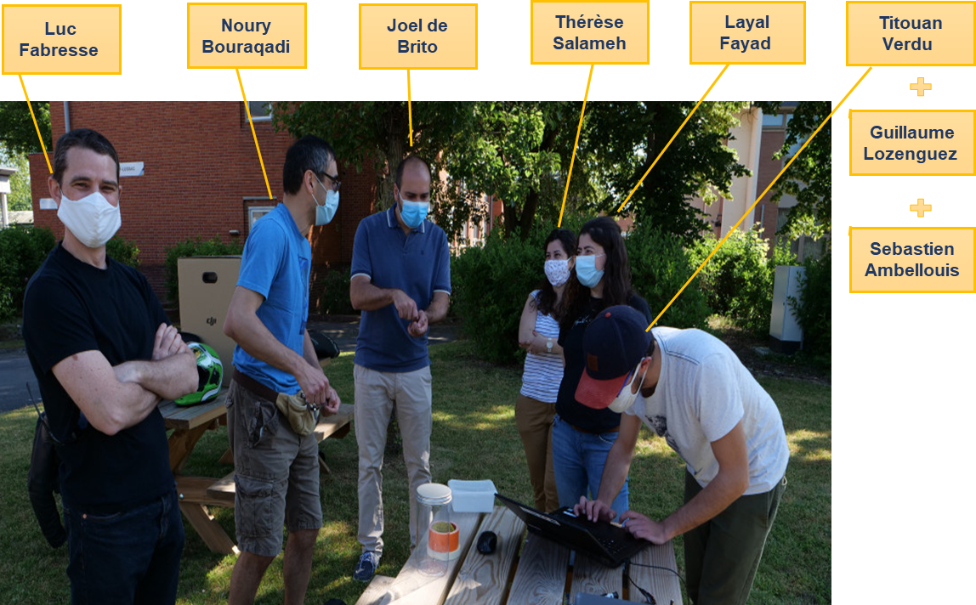
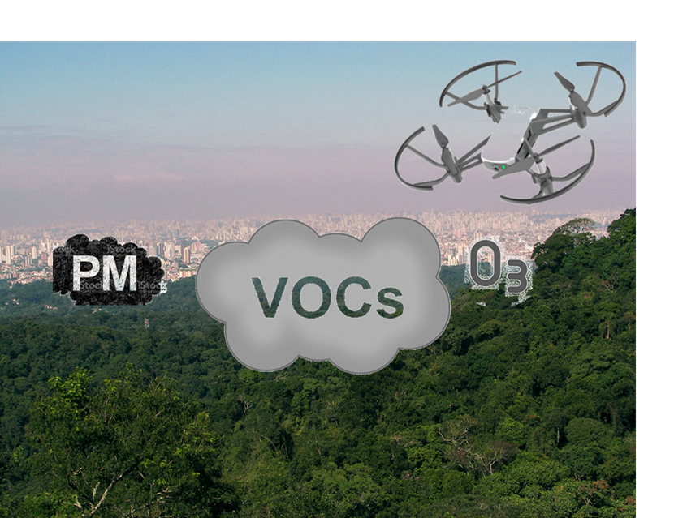
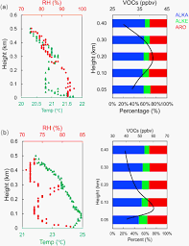
The ALPAGA project
(AeriaL Platform for sampling Atmospheric Gases and Aerosols)
Collaboration between Digital System center and the Energy and Environment center
Development
Programing
Field deployment
Mapping of pollutants

Slide 4




Objectives
Overview
Development of two samplers
Characterization of tedlar bags
Sampling flights

Slide 5
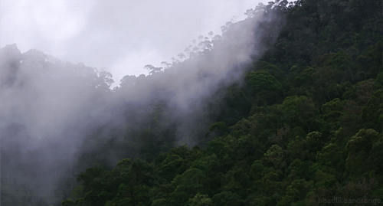
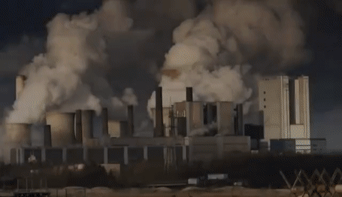


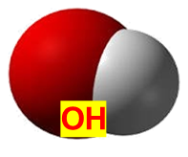
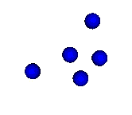
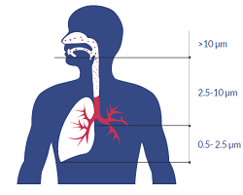
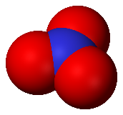
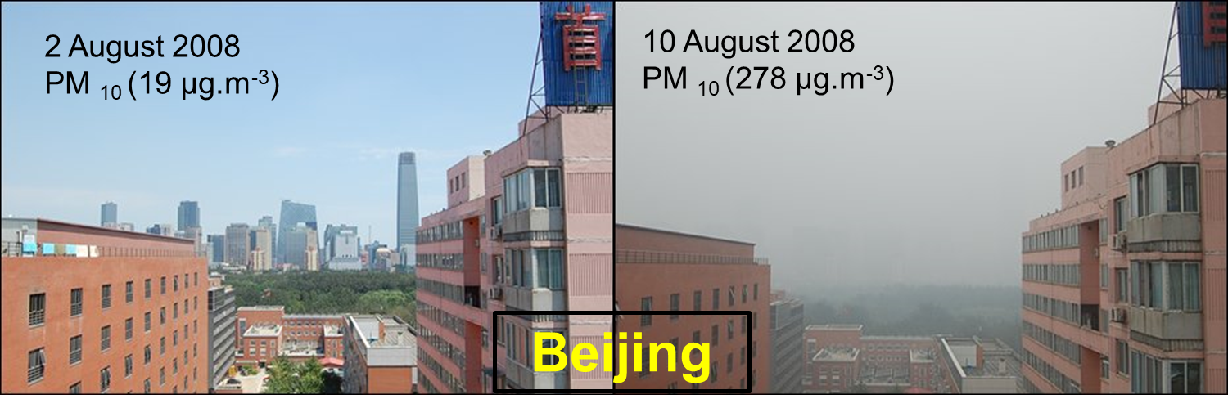


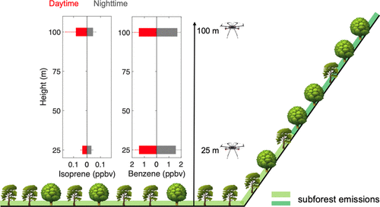
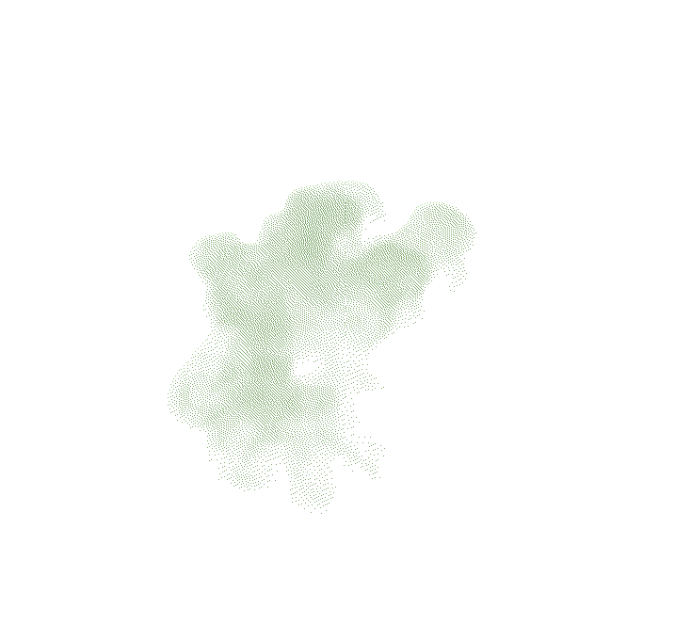
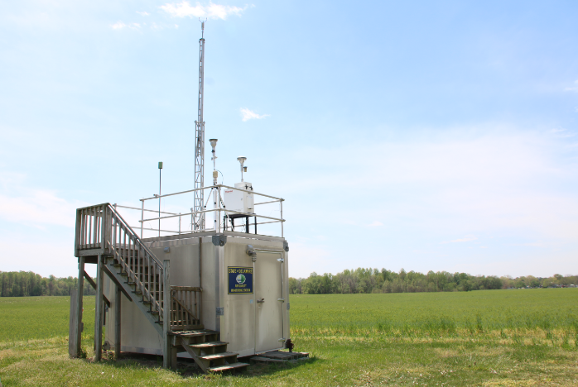
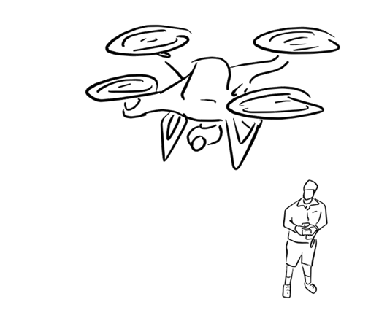

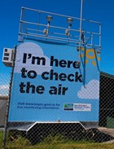




Volatile organic compounds
Sources and impacts of VOCs
Secondary Organic Aerosols
O₃
NO₃
NO₃
O₃
Natural
Anthropogenic
Transport of VOCs
Measurement of VOCs
VOC
VOC
VOC
Ground

Slide 6
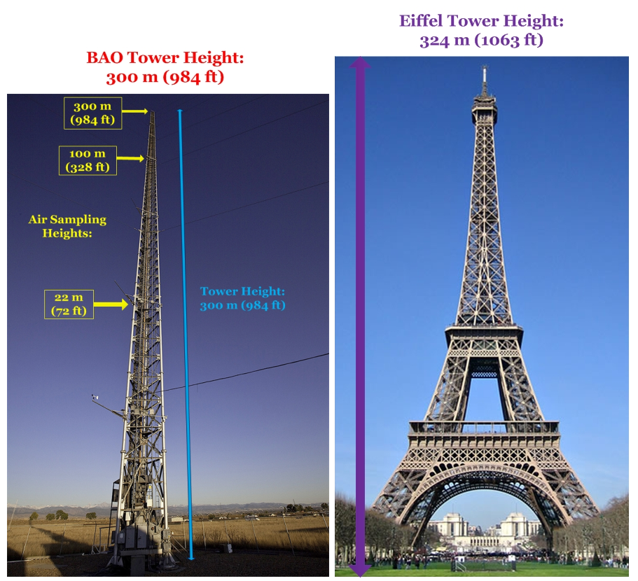
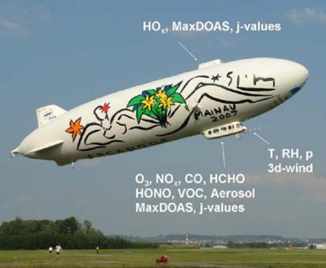
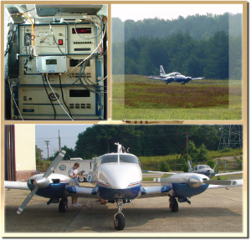
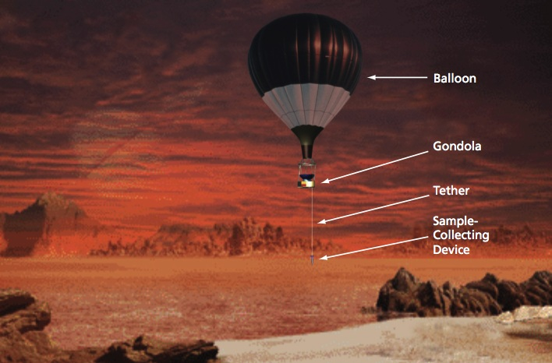
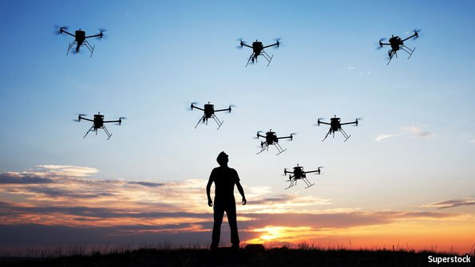
Means of atmospheric sampling
Tradition ways of sampling at high altitudes
airships
aircrafts
tethered balloons
meteorological towers
Unmanned aerial vehicles = drones
Small
Maneuverable
Drones replace/complement the tradition ways of sampling
~ Cheap
Easy deployable
Reach hazardous areas

Slide 7
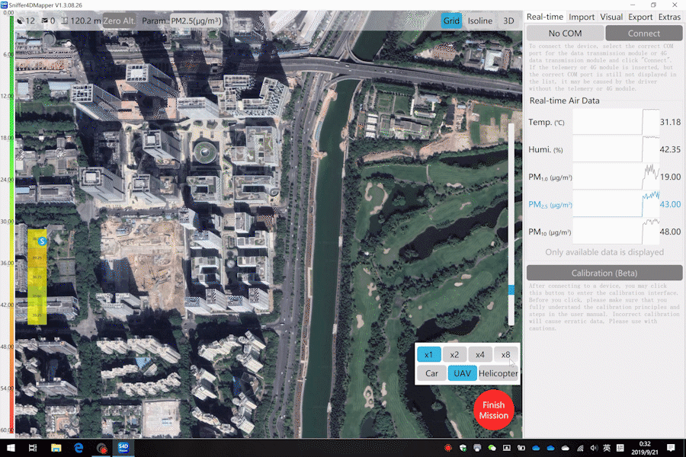
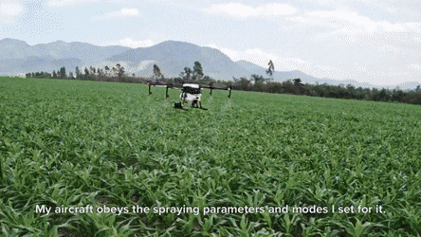
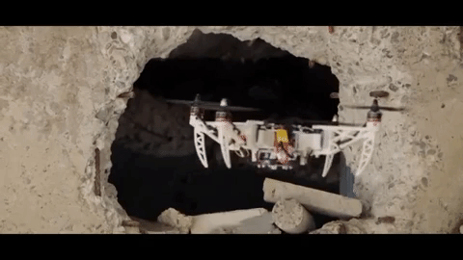
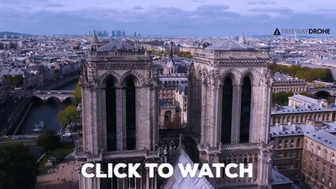
Uses of drone
Measuring and mapping of atmospheric constituents
Agricultural tasks
Safety and security
Photography

Slide 8
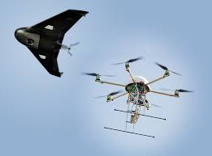

Categories of drones
Aerial drones can be classified:
  according to their design:
  Fixed wing mainly used for sampling over long distances
  Rotary-wing used on localized studies
  according to the
  Weight (C₀<250 g, C₁< 900 g, C₂< 4 kg, C₃ & C₄<25 kg)
  Speed
  Registration requirements
  Pilot competences & requirements (training, examination)
  Operational restrictions (away from airports, below 120m)

Slide 9
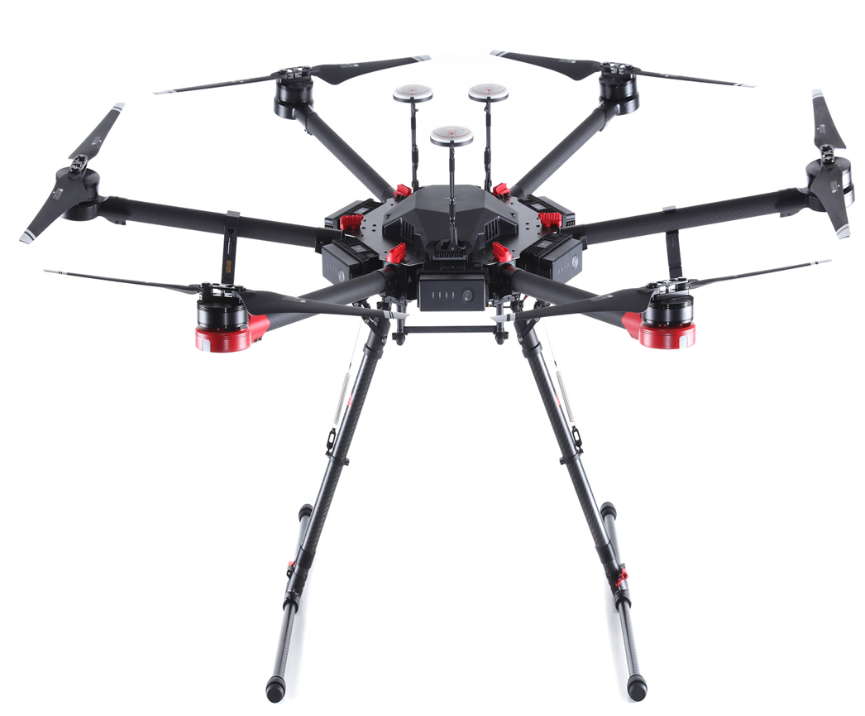
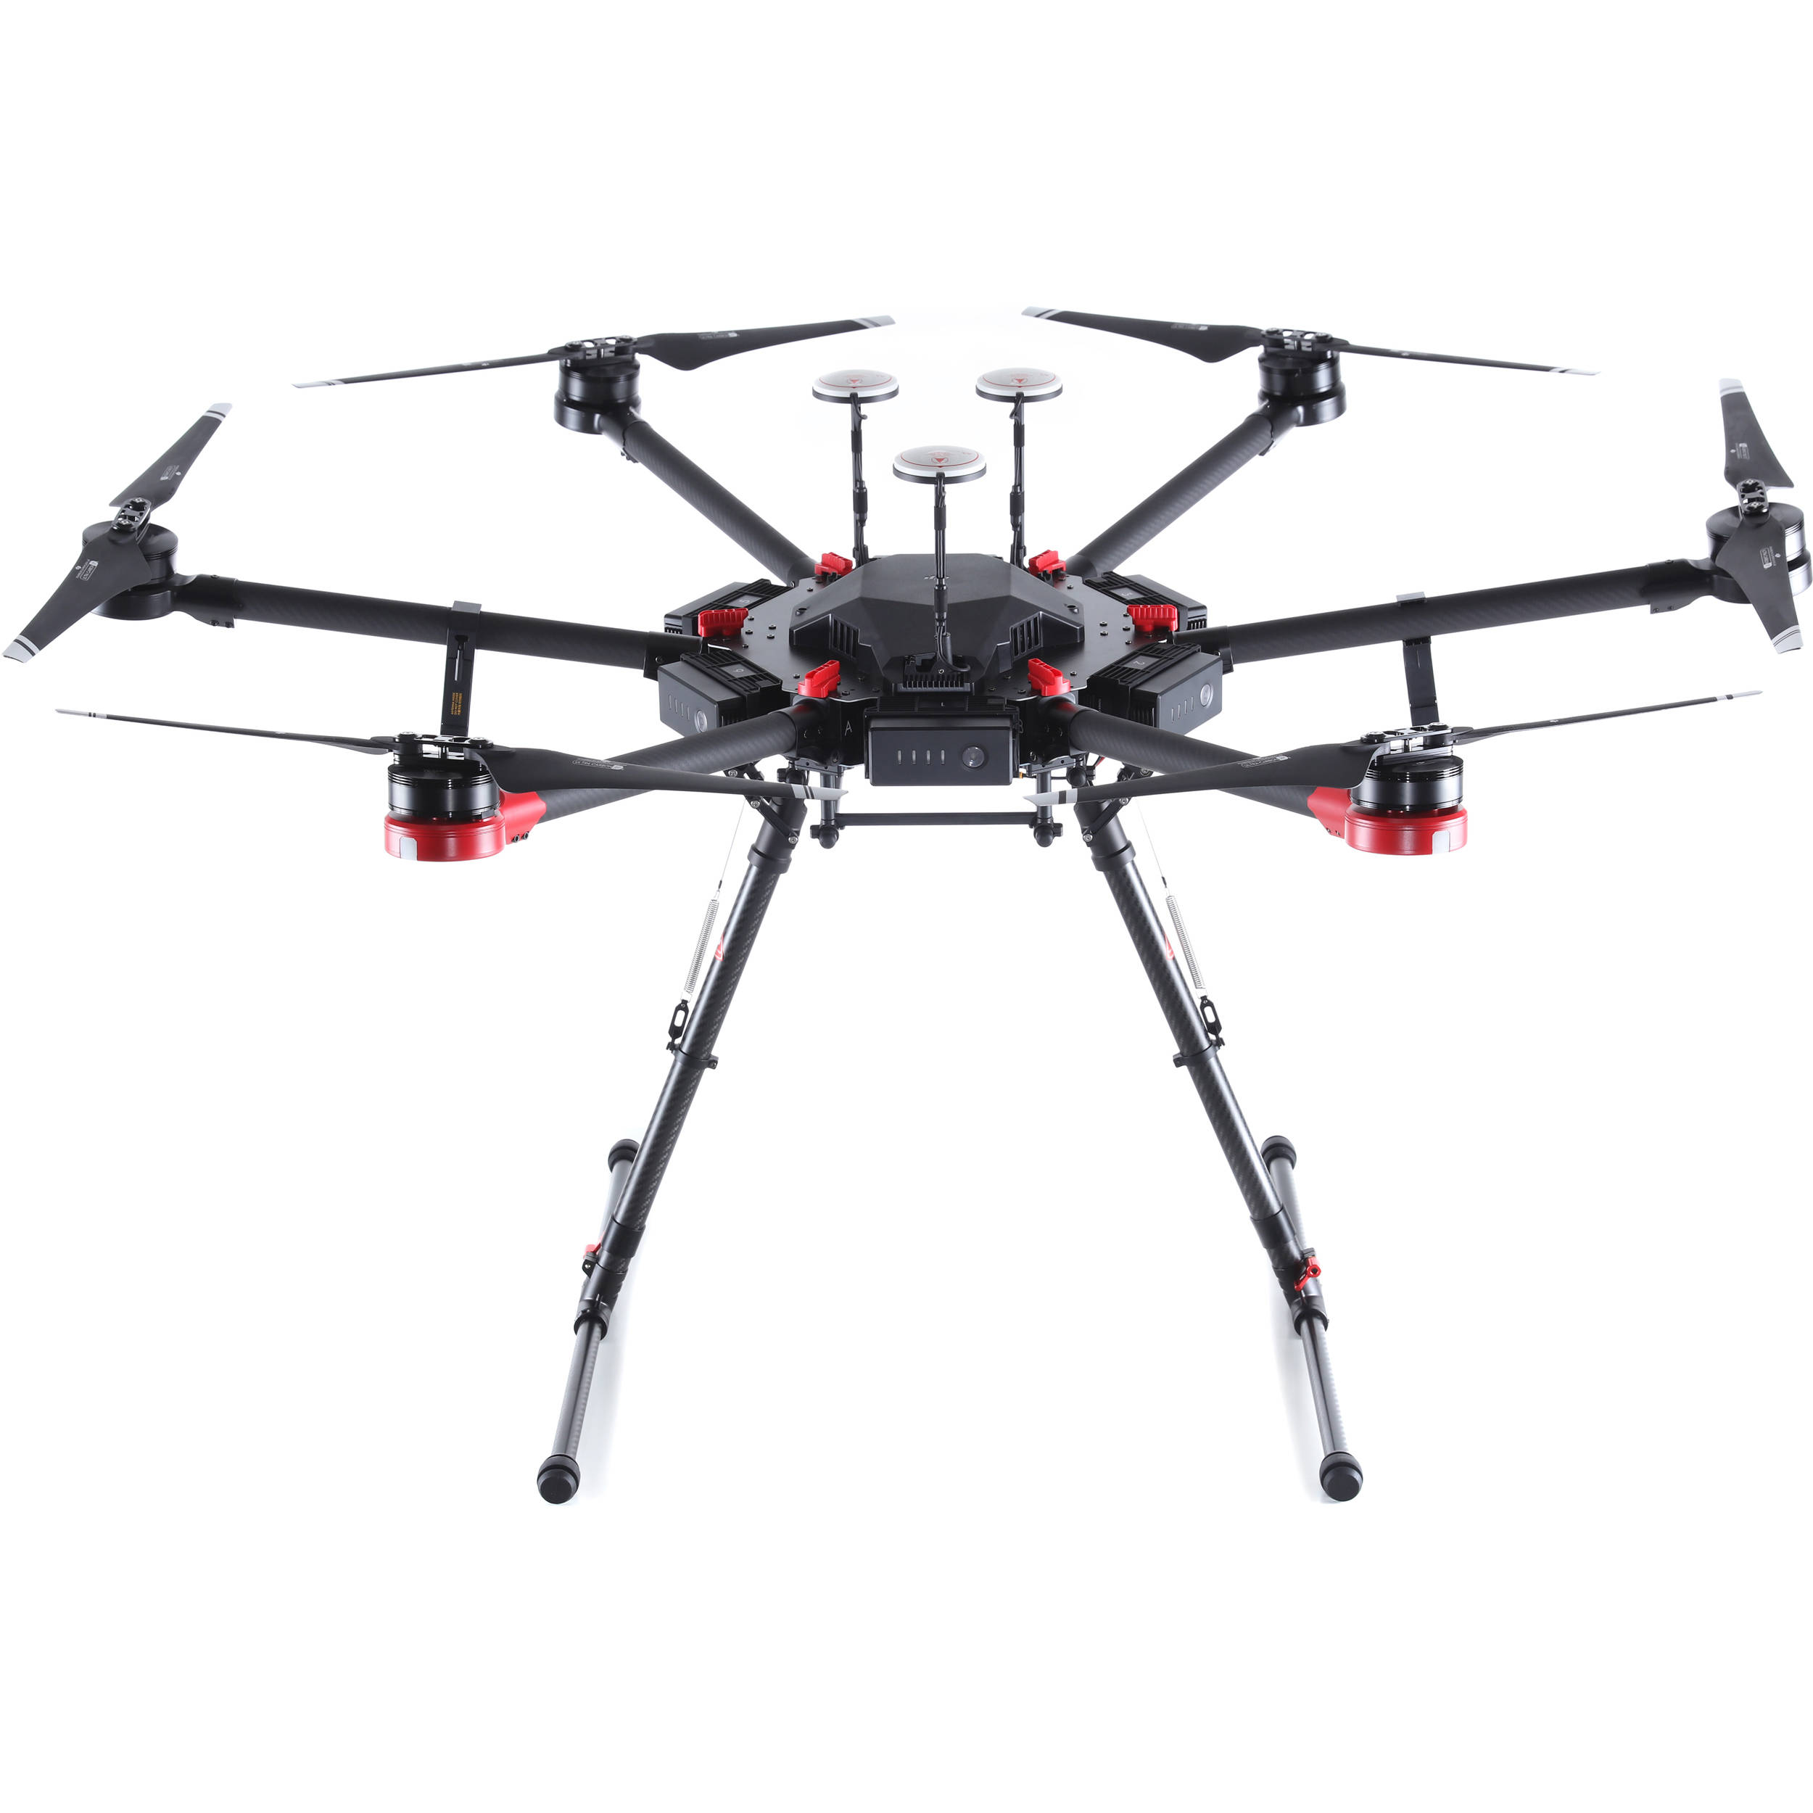

Our drone (DJI M600 PRO)
GPS A3 pro
5
4
Propellers
6
3
1
Batteries
2
72 cm
Drone: 9.5
Max Payload: 6
Landing gears
151 cm

Slide 10
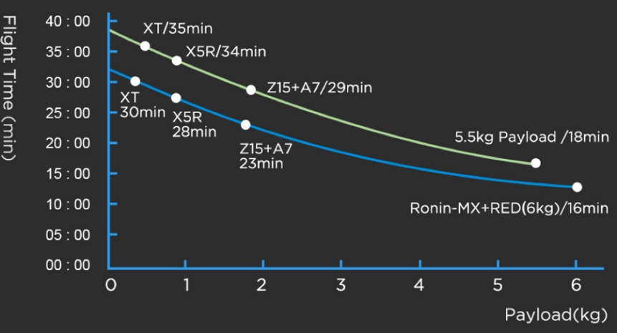
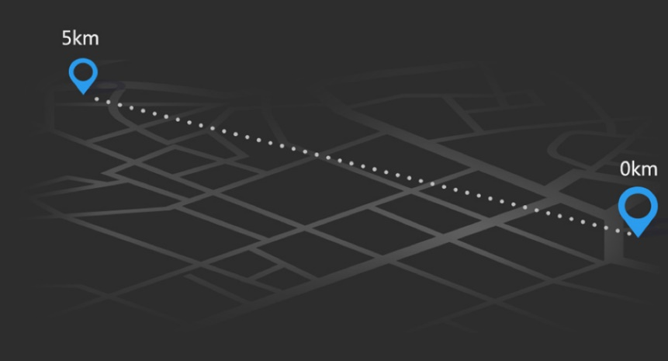
DJI M600 PRO
video

Slide 11

Development of the sampling systems

Slide 12
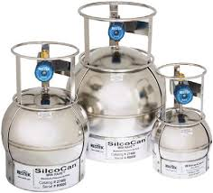
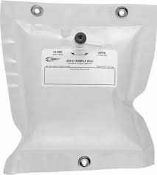
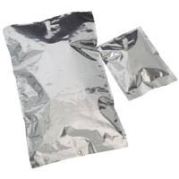
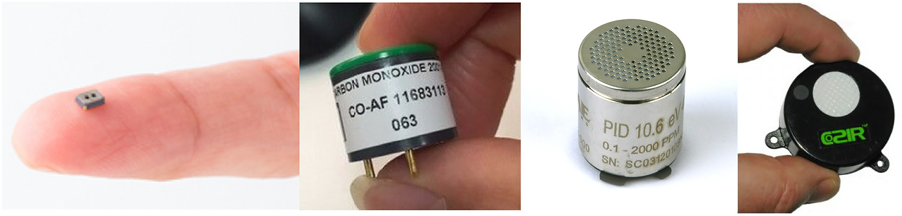
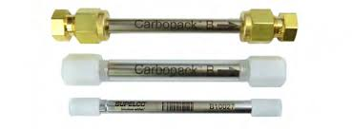



Sampling tool / The choice!
Canisters | Bags | Sorbent Tubes | Sensors
Our requirements
Light weight
Short sampling time
More than one sample/flight
Sampling wide range of VOCs
Innovative tool for an aerial system
Additional and Complementary

Slide 13
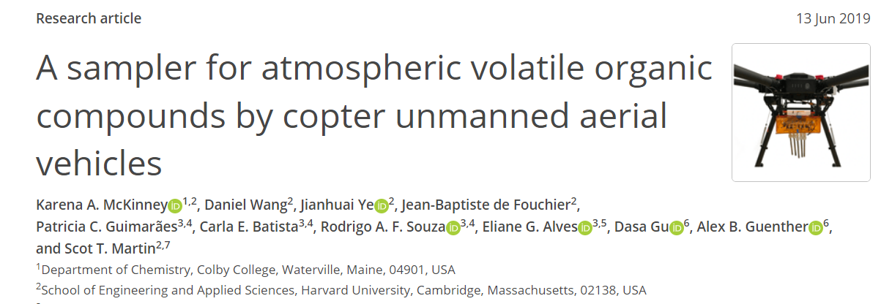
System 1: Automated sampler for cartridges

Slide 14
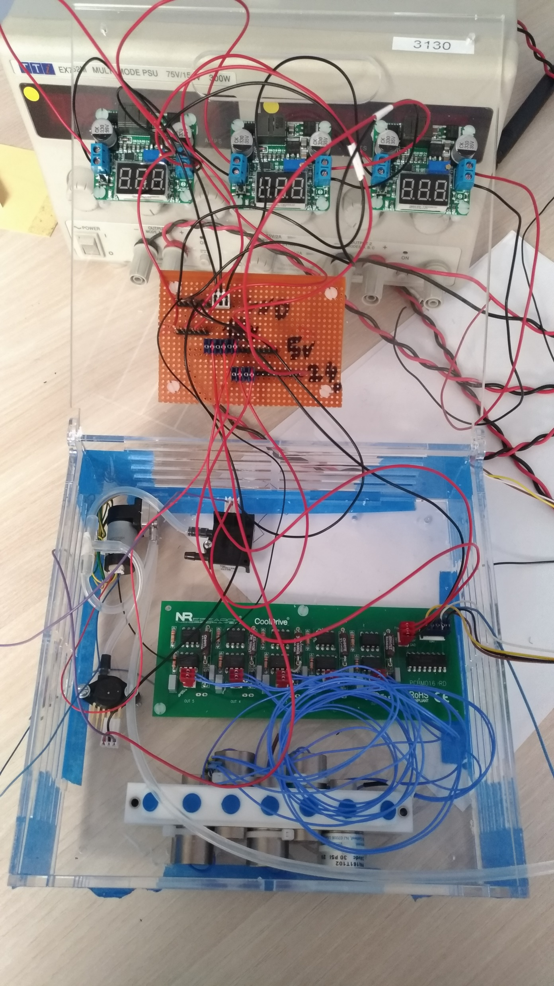


The developed tubes system
Made up of four mains sections:
Electrical: UAV batteries + voltage convertors+ connecting wires
Pressure control : Mass flow sensor + Micro pump + Pressor sensor
Operation control: Arduino Uno microcontroller + driver board
Sampling: Solenoid Manifold + Cartridges
The assemblage of system is done
The operation and automation of the sytem is uncompleted

Slide 15


System 2: The idea!
Requirements: Airtight, light, used for several bags and cheap
Drawing air into the bag without going directly through a pump
To fill the sampling bags directly by creating a negative pressure in a rigid object
valve
Bag
Pump

Slide 16
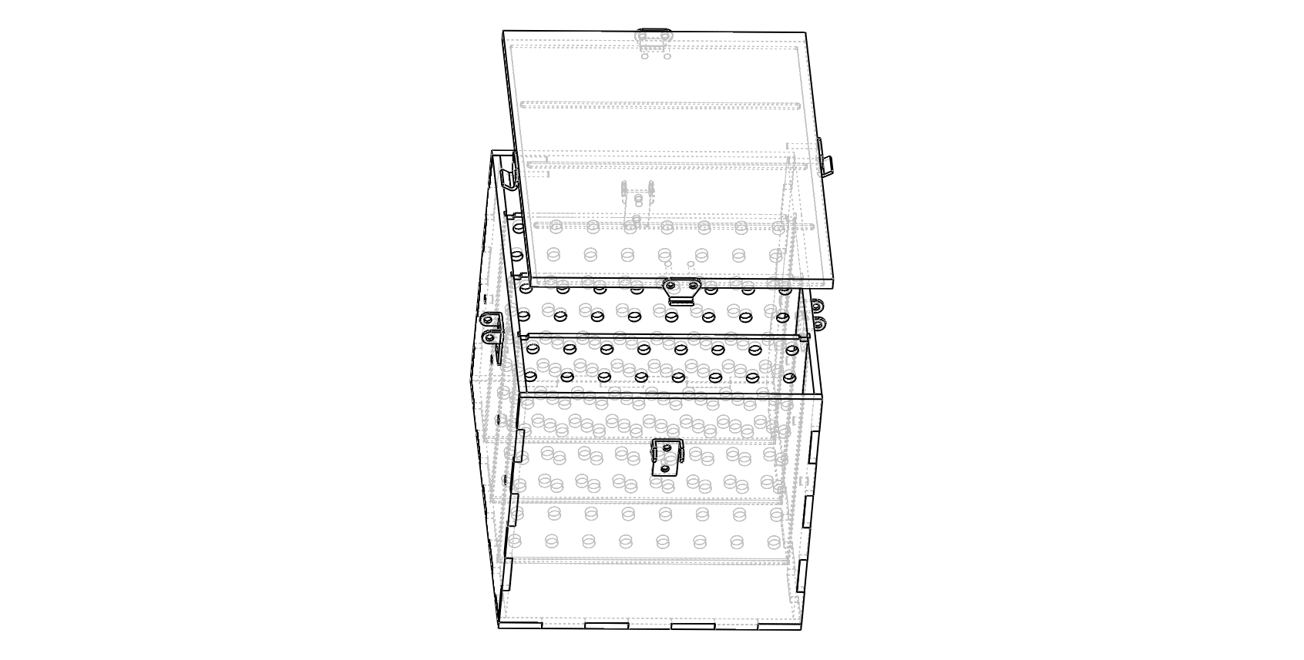
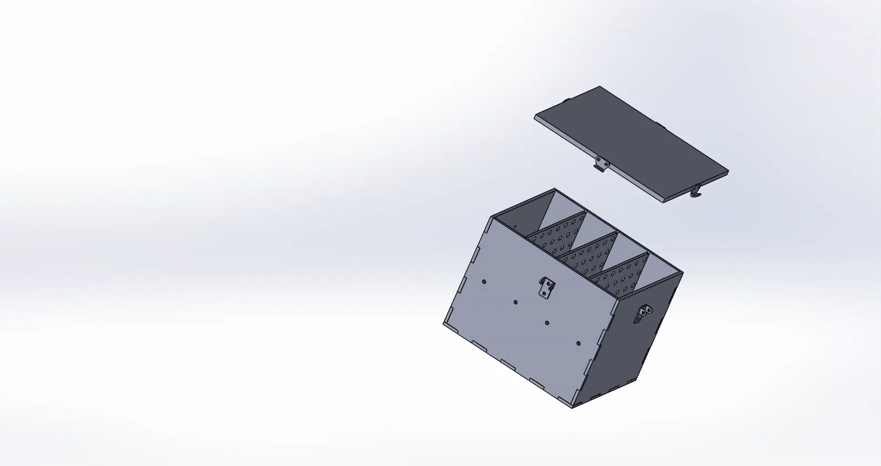
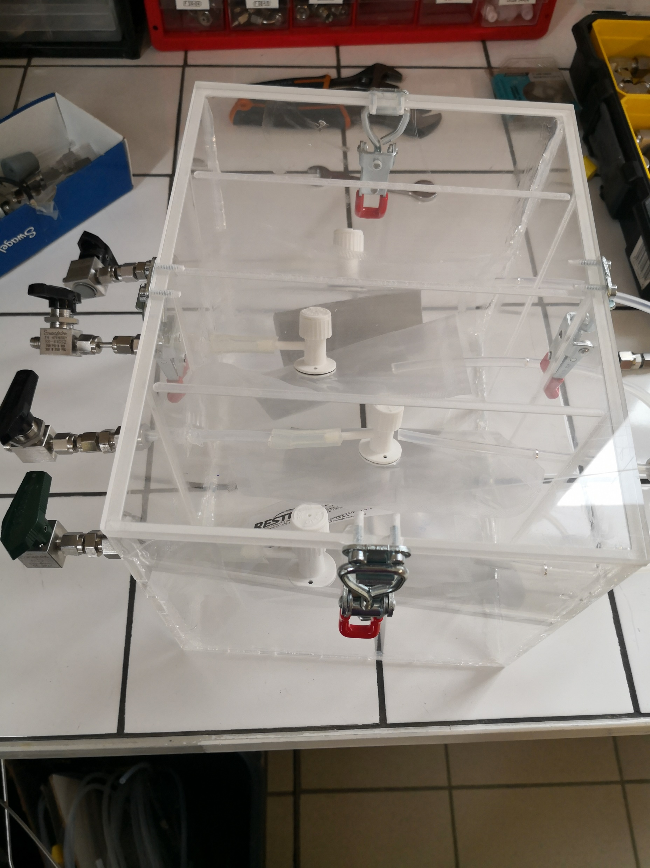
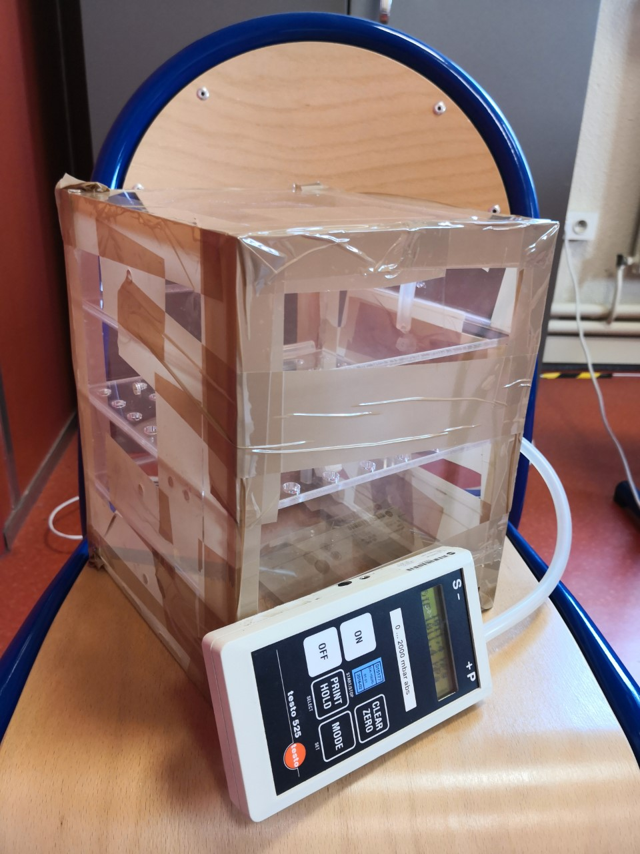


First trial
A box made of Poly(methyl methacrylate) (PMMA) for 4 bags
Dimensions: 25 x 20 x 20 cm
Mass ~ 2.5 kg, heavy
Unaccepted leaks
Thoughts
vs
rEALITY

Slide 17
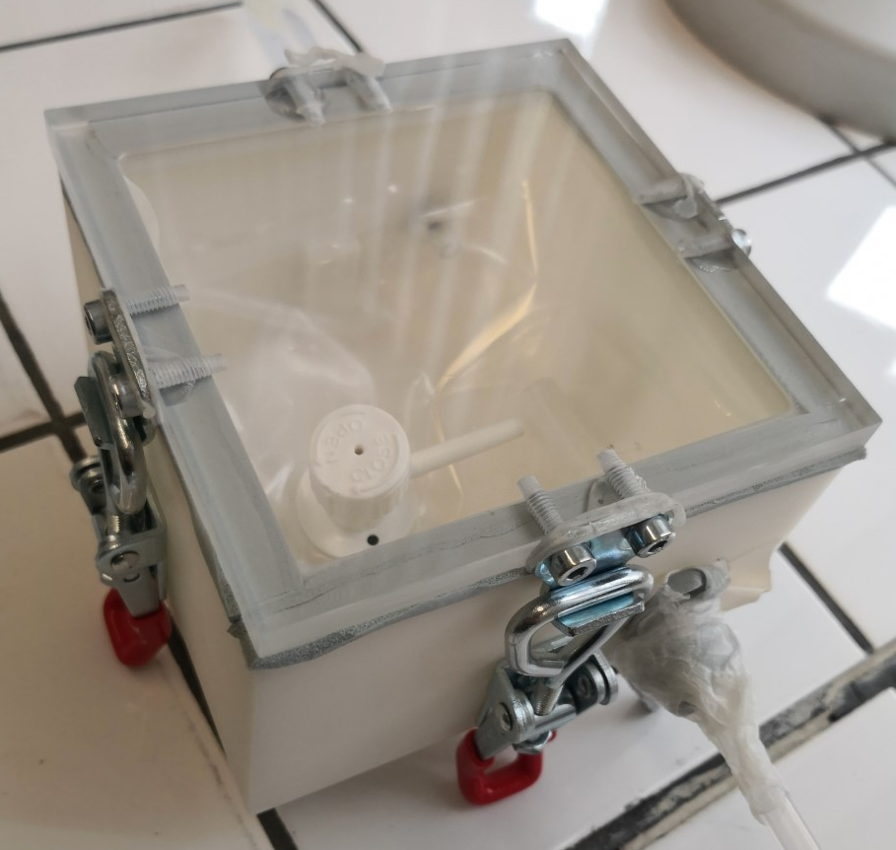
Second trial
A small 3D printed box
Dimensions: 11 x 11 x 5 cm
Tested several types of sealings (silicon, Liège, rubber EPDM)
Presence of leaks ☹

Slide 18

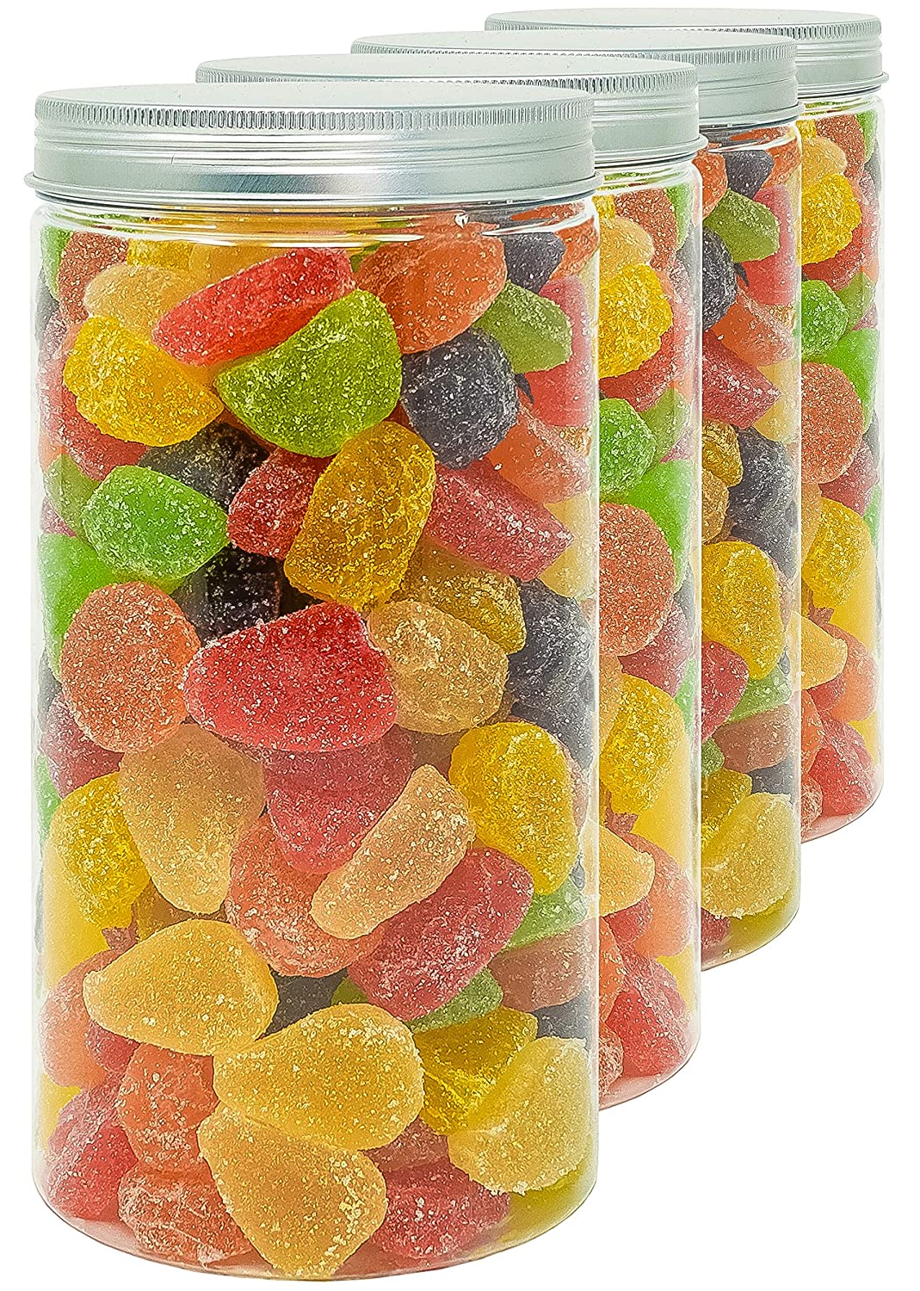
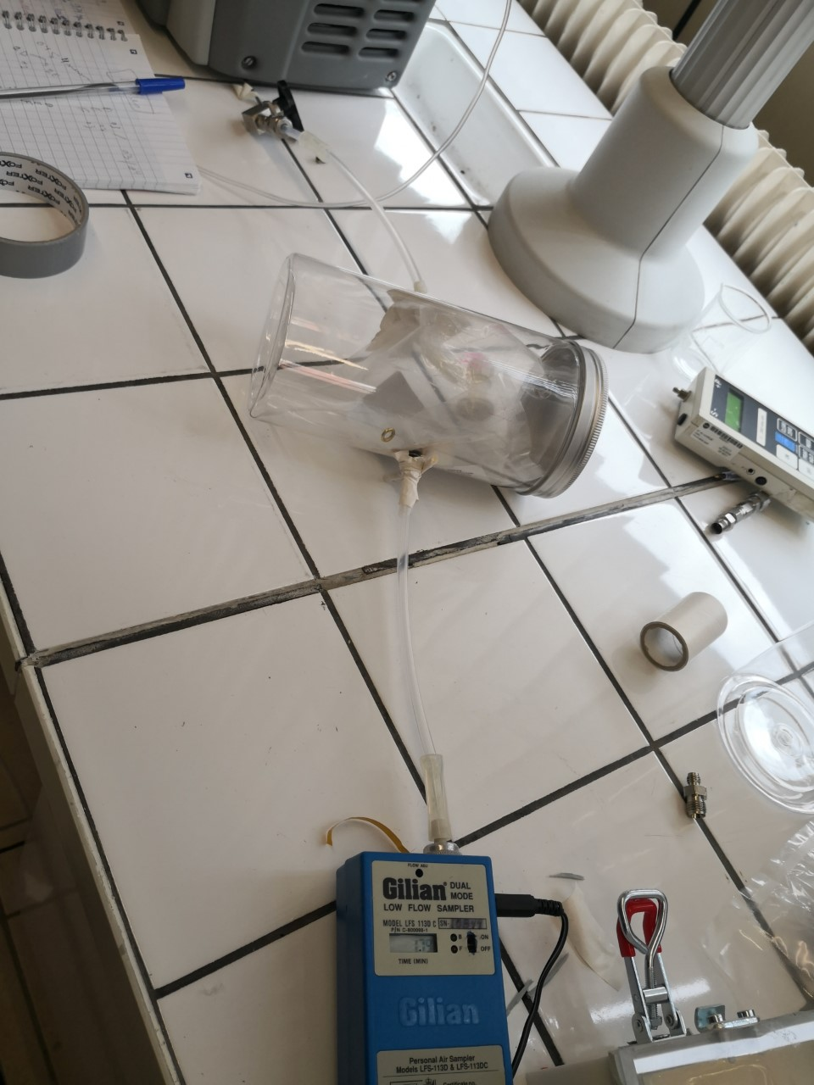
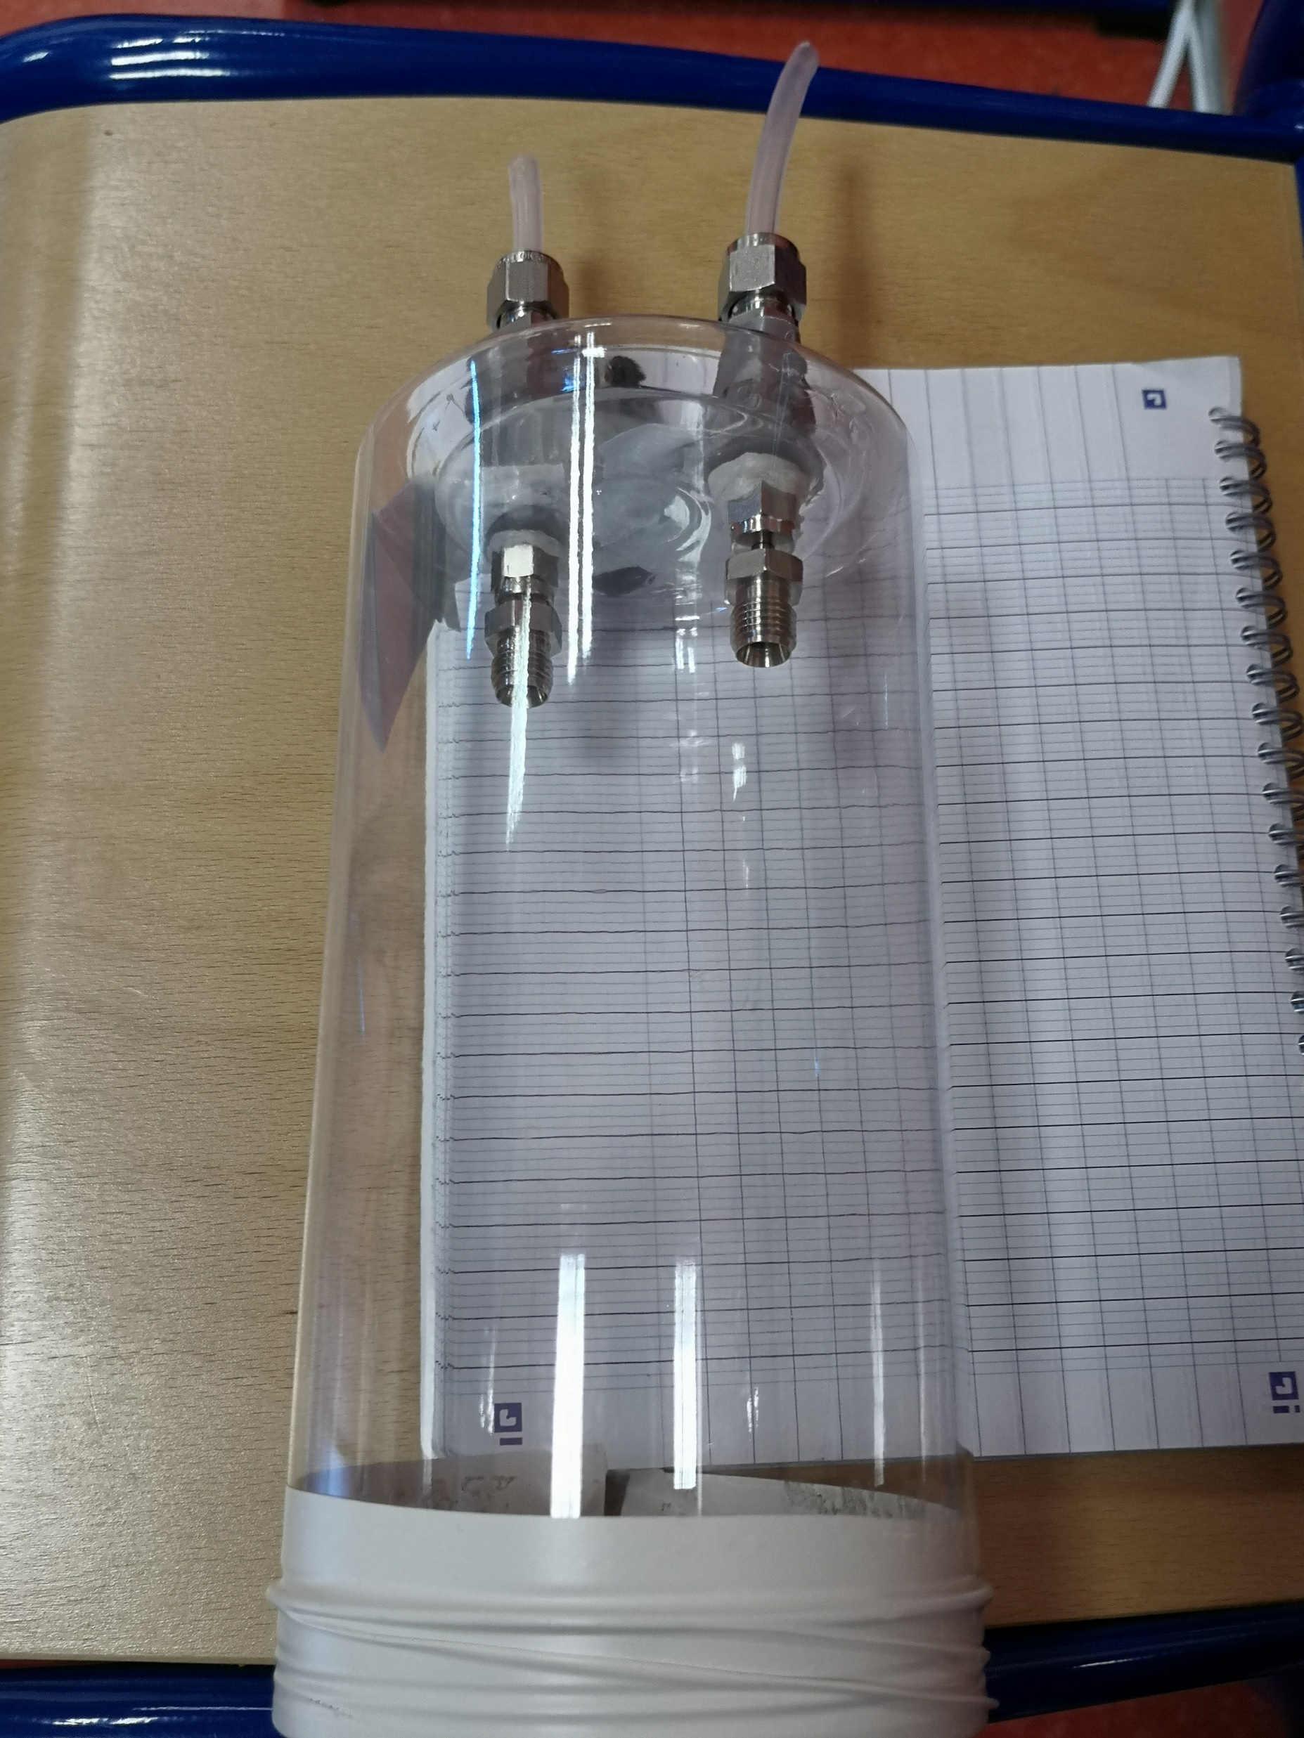
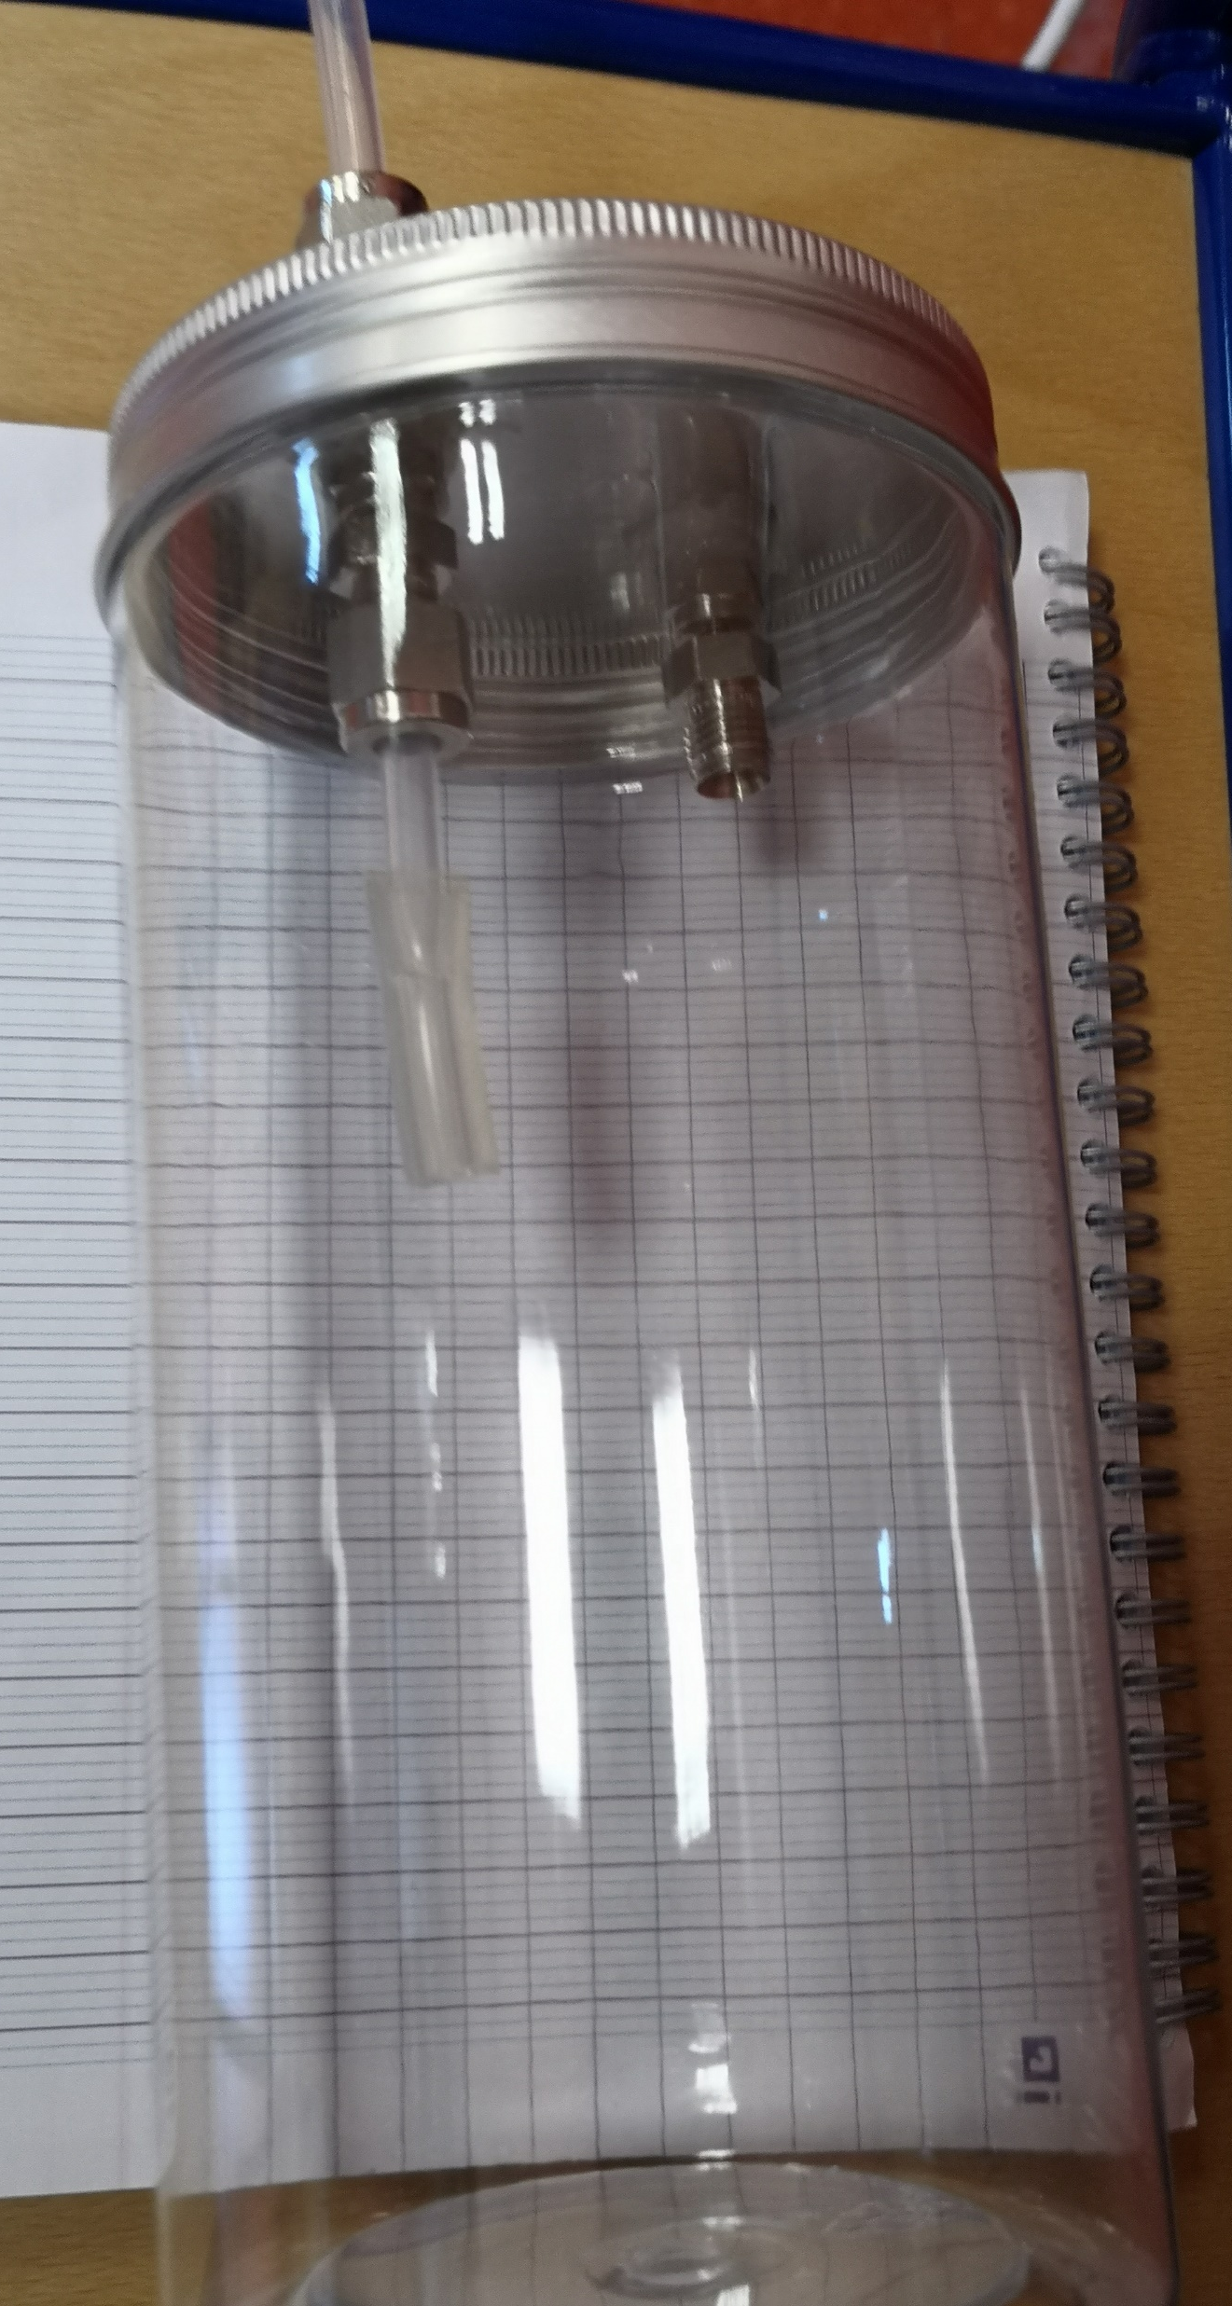
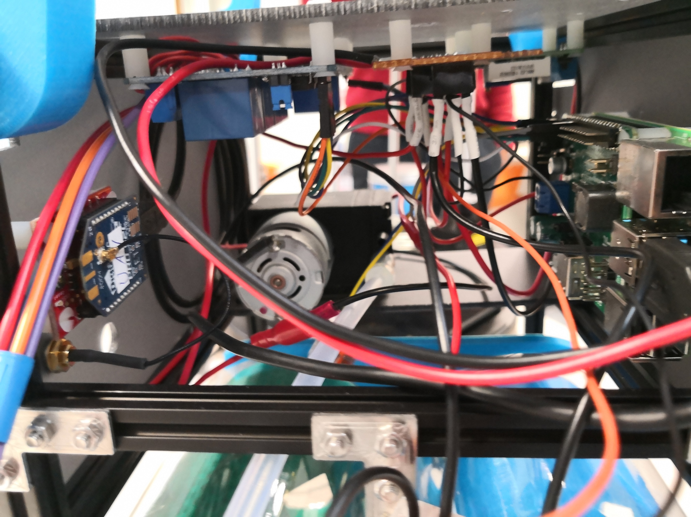
Third trial
Commercial plastic polyéthylène jar container
The basic structure:
  Cylinder
  Bag
  Pump
1.5 L (20x10 cm)
Light
Few euros
Tight
Test:
Different positions of holes
Different fittings and sealants (Teflon, stainless steel Swagelok)
The automation unit:
  Solenoid valve
  The microcomputer Raspberry Pi 4 Model B.
  Power supply board module (StromPi 3)
  Voltage convertors (BuckBoost0)
  Relay module board shield
  *The system is powered from the drone’s batteries

Slide 19
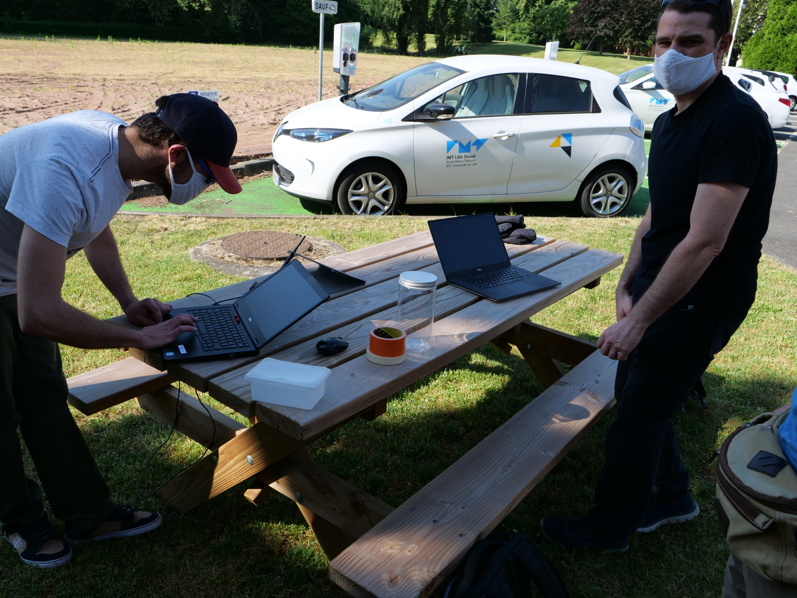



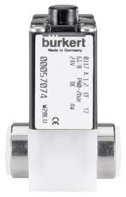







The method
Send the command
Open the solenoid valve to start sampling
Solenoid Valve
Pump the cylinder
Cylinder
P₀=1013 mbar
Reach the required low pressure
P = 900 mbar

Slide 20




The nacelle and the design
Design 1
Design
2

Slide 21
Characterization of tedlar bags

Slide 22
Background analysis
Restek tedlar bags (V=500ml)
0.3
0.8
0.3
0.8
0.07
0.2
0.2
0.07
0.2
0.2
Major contaminants:
Toluene
Acetone
Acetaldehyde
MVK
0.3
0.8
0.07
0.2
0.2
Flushing the bags with pure N₂ for more than 3 times reduces the initial contamination

Slide 23
The storage stability of VOCs in bags
The storage different VOCs (alcohol, nitrile, aldehyde, ketone, terpene and aromatic) was assessed using the (PTR-MS) at different storage times
80% of the bag (400 ml) was filled ~ 30 ppb
Recovery rates within 10 h of storage Beauchamp et al., (2008),
99% for methanol
93% for α-pinene,
81% for isoprene,
85% for acetaldehyde
67% for acetonitrile.
Recovery rates within 24 h of storage of Toluene ~75%
Wang et al., (1996)
Sorption of some compounds on the inner bag walls or sampling valve fittings

Slide 24
Sampling Flights

Slide 25


Where / When?
50°22'30.0"N 3°04'06.9"E
1st sampling flight 18/11/2021
2nd sampling flight 25/11/2021
At 16:00 h
P= 1029 mbar
T= 12°C, RH= 78%
At 16:00 h
P= 1013 mbar
T= 7°C, RH= 85%
NO (ug/m³) | NO₂ (ug/m³) | PM 10 (ug/m³) | PM 2.5 (ug/m³) | O₃ (ug/m³)
3.6 | 29.9 | 25.1 | 9.7 | 21.4
NO (ug/m³) | NO₂ (ug/m³) | PM 10 (ug/m³) | PM 2.5 (ug/m³) | O₃ (ug/m³)
2.6 | 17.7 | 9.3 | 5.1 | 23.6
Atmo-hdf

Slide 26




Sampling heights
H= 50 m
H= 30 m
H= 10 m

Slide 27


Results of the sampling flights
1st sampling flight 18/11/2021
System of 4 cylinders placed on top of each others
Solenoid valve and pump were connected to the lid of the cylinder
Sampling time/ each cylinder = 40 s (pump= 20 s, pump+ SV= 20 s)
Sampled volume/ each sac : 110 - 220 ml
2nd sampling flight 25/11/2021
System of 3 cylinders place horizantally next to each other.
Solenoid valve and pump were connected to the body of the cylinder
Sampling time/ each cylinder = 28 s (pump= 8 s, pump+SV= 20 s)
Sampled volume/ each sac : 340 - 400 ml

Slide 28
Results of the sampling flights
18/11/2021
The vertical distributions of VOCs:
Mixing ratios↓ with the ↑ of altitude
Sources of VOCs:
Vehicle exhaust
Motor engines
Wood burning
25/11/2021

Slide 29
Results of the sampling flights
18/11/2021
The results for OVOCs were not expected (too high) ☹
Unidentified sources of contamination that should be further investigated
25/11/2021

Slide 30


Conclusion & Perspectives
This work represents:
  The development of two VOCs samplers (tubes and bags) for drone measurements
  The different tests performed to characterize tedlar bags
  The results of 2 sampling flights (November 2021- Douai) to (i) validate the operation of the bag sampler and to (ii) measure the concentration of VOCs
This work is the first accomplished project of our group to sample VOCs via drone, regardless the different constrains
  The weather conditions
  The availability of the analytical instruments
  The availability of the pilot to fly the drone
There is still much to be done!
Technical optimization of the bag-system (ex: installing a pressure sensor)
Finalizing the tube-sytem and operating it
Coupling the Advanced Mixing Condensation Particle Counter (aMCPC)
Model 9403 (Brechtel) to the drone
Deploying the drone at different sampling sites and field campaigns

Slide 31


layal.fayad@imt-nord-europe.fr
fayadlayal@hotmail.com

